Slide 1
Supporting Language:
Equity, Identity & Inclusion
Dennis L. Rudnick, Ph.D.
He/Him/His
Assistant Professor of Multicultural Education
Missouri State University

Slide 2
Objectives
Detail key supporting language concepts and considerations.
Application of concepts and considerations to our professional and personal lives.
Set the stage for the conference and workshops.

Slide 3
Evidence Based Practice
(Portney, 2020)

Slide 4
Cultural Humility
Process of self-reflection and discovery in order to build honest and trustworthy relationships and practices.
The recognition of diversity and power imbalances among individuals, groups, or communities;
The actions of being open, self-aware, egoless, flexible, exuding respect and supportive interactions;
Focusing on both self and other to formulate a tailored response;
A process of critical self-reflection and lifelong learning, resulting in mutually positive outcomes.
(Foronda, 2020; Tervalon and Murray-Garcia, 1998; Yeager & Bauer-Wu, 2013)

Slide 5
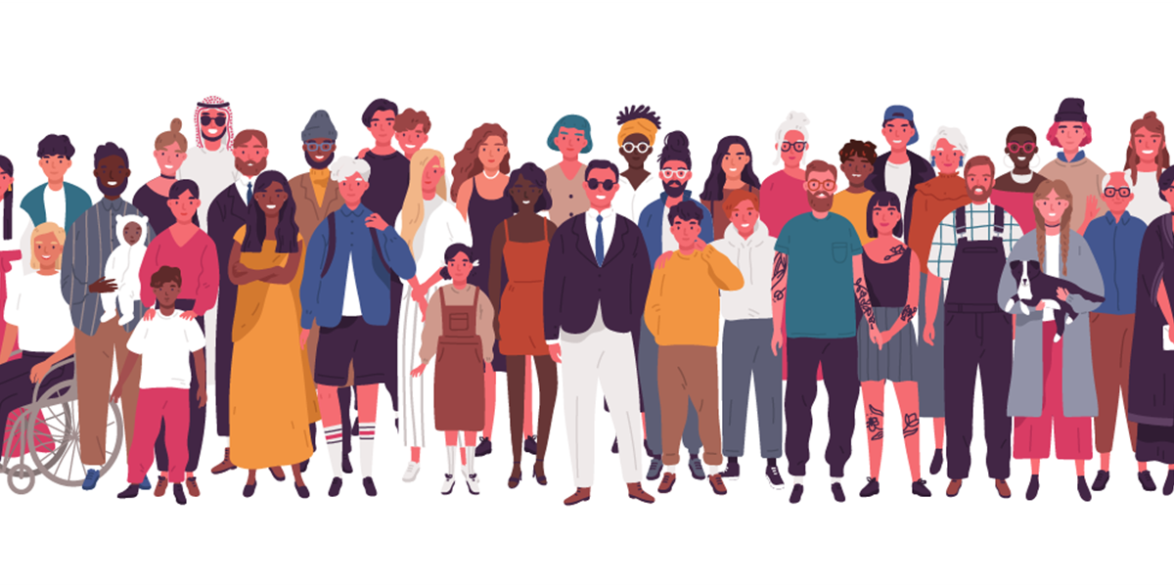
Diversity
The wide variety of shared and different personal and group characteristics among human beings.
The presence of diversity indicates generally that many people with many differences are present in a group, organization, or institution.
(Adams et al, 2018)

Slide 6
Equity
The quality or state of being fair and just.
Whereas equality is treating everyone the same, equity accounts for context.
Equitable approaches, policies, and practices may make accommodations for differences to ensure fair and just outcomes.
Equity is concerned not just with opportunity, but also with the barriers that make those opportunities unequal.
(Adams et al, 2018)

Slide 7
Equity
(Adams et al, 2018)

Slide 8
Equity
Removing the fence is specific to policy, practice, and position changes and institutional improvements.
(Adams et al, 2018)

Slide 9
Inclusion
The act of creating environments in which any individual or group can be and feel welcomed, respected, supported, and valued to fully participate.
(Adams et al, 2018)

Slide 10
(Adams et al, 2018)

Slide 11
Social Identities
Socially constructed, contextual, and contested
Self- and Societally ascribed categories
Prescriptions for ways of “acting”
Real and perceived
(Hogg, Abrams, & Brewer, 2017; Yep, 2015)

Slide 12
Social Identities
Visible and invisible
Saliency
Shape how we perceive and make sense of the world, and how the world perceives and makes sense of us
Markers of relational positions, not essential qualities
(Hogg, Abrams, & Brewer, 2017; Yep, 2015)

Slide 13
Gender, Sex, and Sexuality
Language about gender, sex, and sexuality identities and expressions are complex and ever changing. www.thinkagaintraining.com
Biological Sex and Sex Assigned at Birth
Gender Expression
Gender Identity
Passing
Sexual Orientation
Transition

Slide 14
Identity Categories
Language about gender, sex, and sexuality identities and expressions are complex and ever changing. www.thinkagaintraining.com
Cis or Cisgender
Trans or Transgender
Crossdresser
Drag Kings & Drag Queens
Genderqueer
Intersex
Queer
Transsexual
Transman
Transwoman

Slide 15
Cisgender & Transgender
Cisgender: a description for a person whose gender identity, gender expression, and biological sex all align.
Transgender: a description for a person who have an experience of transitioning (socially, legally, and/or medically) from living as one gender to another gender
Adjective, not a noun or verb

Slide 17
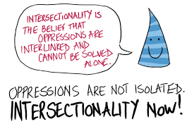
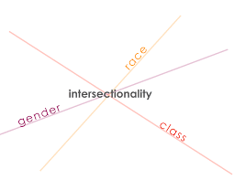
Intersectionality
Focuses on the intersections of multiple, mutually-reinforcing systems of identity, oppression, power, and privilege.
Recognizing people’s lives are multi-dimensional and complex; we expect multiple stories.
Human lives cannot be explained by single categories.
Lived experience is an interactive process that goes beyond individual labels.
Lived experience is shaped by the interaction of identities, contexts and social dynamics.
People can experience privilege and oppression simultaneously.
(Crenshaw, 1989); Yep, 2015)

Slide 18
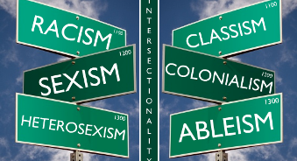
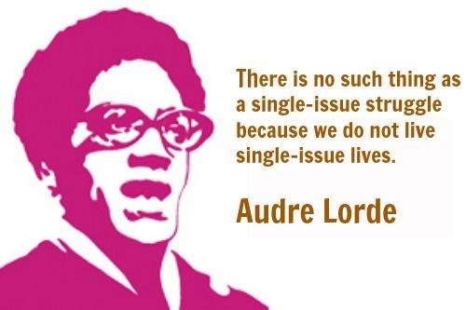
Intersectionality
Structural inequity interacts with contextual factors and social dynamics, increasing marginalization, inequity, and health disparity.
To understand someone’s experience, we must also understand structures and systems.
Relationships involve power dynamics and power imbalances are inevitable. The question is how we acknowledge and negotiate power, particularly in institutions.
Reflexivity can support service providers to increase their awareness of their positions of power.
Urges transformation and collective work towards social justice.
(Crenshaw, 1989); Yep, 2015)

Slide 19
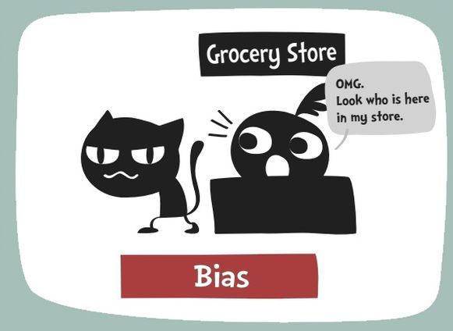
Bias
A tendency, preference, or an inclination, especially one that inhibits impartial judgment.
Conscious and subconscious processing of information. Subconscious attitudes and behaviors are referred to as implicit bias.
Value in bias—automatic decision making, danger detector, necessary.
Challenges with bias—incorrect application of assumptions, quick emotional decision making.
(Project Implicit; Ross, 2008)

Slide 20
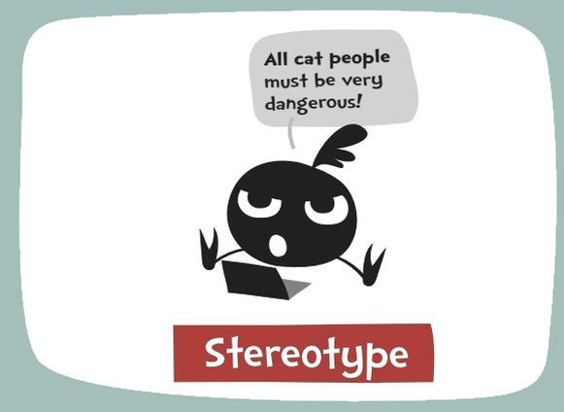
Stereotypes
Set of overgeneralized beliefs (traits, behaviors, and motives) about members of a social group.
Can be positive or negative (although positive stereotypes can have negative consequences).
Social constructions
(Fiske & Tablante, 2015)

Slide 21
Microaggressions
Everyday slights, indignities, put-downs, and insults that communicate hostile, derogatory, or negative messages to persons based on their marginalized group membership(s).
Can appear to be a compliment but contain a “metacommunication” or hidden insult to the target groups to which it is delivered.
(Sue, 2017)

Slide 22
Microaggressions
Often unconscious
Intent vs. Impact
Cumulative effect
Similar to carbon monoxide—“invisible, but potentially lethal”—continuous exposure to these types of interactions “can be a sort of death by a thousand cuts to the victim”.
(Sue, 2017)

Slide 23
Microaggressions: Impact
Psychological (anxiety)
Physical (stress)
Inequitable treatment (healthcare, education, employment, discipline)
Such messages mark:
Who belongs and who does not.
Who is worthy of empathy, care, and resources and who is not.
(Sue, 2017)

Slide 24
Prejudice, Discrimination, and Isms
Prejudice: Learned negative beliefs about a social group or members of a group based on simplistic assumptions and stereotypes. Anyone can hold prejudices about other groups.
Discrimination: The action of limiting access to goods, opportunities, or resources or negatively singling out someone for unequal treatment based on group membership. Discrimination is perpetuated by individuals and institutions and can happen whenever someone has the power to deny opportunity or resources.
Ism (e.g., Racism, Ableism, Sexism, Heterosexism, Ageism, Classism): A centuries-long, multi-faceted, and self-perpetuating system of oppression in which some people have greater access to political, economic, and ideological power, and as a group have benefitted from the continued and cumulative impact of that power.
Ism = (Prejudice + Discrimination) X (Power +Time)
(Schmidt, 2019)

Slide 25
Systemic Power, Privilege, and Oppression

Slide 26
Power
The ability to achieve goals even when others oppose those goals.
Not inherently bad. Think of it like fire, it can be beneficial or it can be destructive.
Unequally distributed in the United States in (at least) three ways that result in systemic oppression:
Political Power: The ability to create and enforce laws and policies that govern the access and use of institutions, resources, and opportunities.
Economic Power: The ability to access, distribute, and accumulate resources such as capital, trade, land, and production chains.
Ideological Power: The ability to shape societal norms, values, and aesthetics in ways that determine what (and who) is considered to be normal, appropriate, just, right, or valuable.
(Schmidt, 2019)

Slide 27
Privilege
Unearned access to social power based on membership in a social group.
Systemic favoring, enriching, valuing, validating, and including of certain social identities over others.
Social arrangements cause privileges to flow to certain groups whether or not they are earned, without awareness or intent, even if there is a desire not to be privileged.
Individuals cannot “opt out” of systems of privilege; these systems are inherent to the society in which we live.
(Adams et al., 2018)

Slide 28
Oppression
Systemic devaluing, undermining, marginalizing, and disadvantaging of certain social identities in contrast to the privileged norm.
Institutionalized power that is historically formed and maintained via the domination of the rights and interests of certain social identity groups over, and often at the expense of, the rights and interests of other social identity groups.
(Adams et al., 2018)

Slide 29
Oppressed Groups
Have less access to power and resources
Generally assumed to be “less than,” “inferior” or “deficient”
Often feel the need to assimilate or to fit in; afraid the challenge the status quo
Have their truth and experiences questioned and invalidated
Relegated to the outer edge of society/community
Sometimes challenged to find their voice or speak up
Very aware of oppression
Privileged Groups
Define what is normal
Make or benefit from the rules
Have greater access to power and resources
Generally assumed to be “greater than” or “better than”
Given the benefit of the doubt
Sometimes feel they have to defend themselves
Often unaware of privilege

Slide 30
Beyond Guilt and Shame

Slide 31
Empowerment
Refuse to accept the dominant ideology and the inferior status assigned to them in a system of oppression.
Work to overcome the internalized aspects of oppression they were socialized to accept.
Take actions to redistribute social power more equitably.
Have pride in their social identities and enjoy a sense of community with others from their social identity groups.,
Develop a liberatory consciousness that leads them to become actively involved in efforts to eliminate oppression. These efforts include working in coalition with allies or working with other targeted group members.
Understand the interconnections among different manifestations of oppression and the importance of challenging them all, not only the ones that affect them most directly.
(Adapted from Govan, 2016).

Slide 32
Allyship
Reject the dominant ideology and take action against oppression out of a belief that eliminating oppression will benefit everyone, not only targeted groups.
Recognize the strengths of oppressed peoples.
Stand up in support of members of another group. If the person is a member of dominant group standing beside member(s) of targeted group, then they use their social power to take a stand against social injustice.
Stand up behind closed doors.
Listen, believe, and follow the lead of those most impacted.
Don’t do it for the “cookie” or pat on the back.
Work to be an agent of social change rather than an agent of oppression.
(Adapted from Govan, 2016).

Slide 33
The R.A.V.E.N. Approach
Redirect (intervene) (correct) (pull aside)
Ask probing questions for clarity
“I think I heard you say…..what did you mean by that?”
“I want to make sure I understand what you were saying, were you saying that…?”
Values clarification
“You know, in this department we work hard to create a space that is safe and welcoming for all clients.”
“What you just said is not in alignment and/or inconsistent with our institutional values that prioritize equity and inclusion.”
Emphasize your own thoughts and feelings
“When I hear your comment, I think/feel”
“Many people might take that to mean.” • ”In my experience. . . . ”
Next Steps
(Wood & Harris, 2020)

Slide 34
Now What?
Intrapersonal: Intentionally engage in self-critique and reflexivity to recognize and accept biases and assumptions.
Interpersonal: Engage in mindful active listening where we ask genuine open-ended questions of the people we encounter to understand their cultural beliefs and practices.
System level: Offer opportunities for individual self-critique and reflexivity during paid work time, offer workshops and space for discussion, and engage in community participatory approaches to develop policies that build a culture of humility.
(Hughes et al, 2020)

Slide 35
Hope doesn’t preclude feeling sadness or frustration or anger or any other emotion that makes total sense. Hope is not an emotion and hope is not optimism. I believe there is always a potential for transformation and change…
I think this grounded hope can be practiced.
Hope is a discipline and we have to practice it every single day.
Hope is really believing in spite of the evidence and watching the evidence change.
-Mariame Kaba, Organizer, Educator, and Curator
http://mariamekaba.com/

Slide 36
References
Adams, M., Blumenfeld, W. J., Catalano, D. J. C., DeJong, K. S., Hackman, H. W., Hopkins, L. E., Love, B. J., Peters, M. L., Shlasko, D., & Zuniga, X. (Eds.). (2018). Readings for diversity and social justice (4th ed.). Psychology Press.
Crenshaw, K. (1989). Demarginalizing the intersection of race and sex: A Black feminist critique of antidiscrimination doctrine, feminist theory and antiracist politics. University of Chicago Legal Forum, 1989(1), 139-167.
Foronda, C. (2020). A theory of cultural humility. Journal of Transcultural Nursing, 31(1) 7–12.
Fiske, S. T., & Tablante, C. B. (2015). Stereotyping: Processes and content. In M. Mikulincer, P. R. Shaver, E. Borgida, & J. A. Bargh (Eds.), APA handbook of personality and social psychology, Vol. 1. Attitudes and social cognition (pp. 457-507). Washington, DC: American Psychological Association.
Govan, I. (2016). Racial Equity: Creating the Beloved Community. http://culturesconnecting.com/racial-equity-creating-the-beloved-community/
Hogg, M. A., Abrams, D., & Brewer, M. B. (2017). Social identity: The role of self in group processes and intergroup relations. Group Processes & Intergroup Relations, 20(5), 570-581.
Hughes, V., Delva, S., Nkimbeng, M., Spaulding, E., Turkson-Ocran, R.-A., Cudjoe, J., Ford, A., Rushton, C., D'Aoust, R., Han, H.-R. (2020). Not missing the opportunity: Strategies to promote cultural humility among future nursing faculty. Journal of Professional Nursing, 36(1), 28-33.
Kaba, M. (n.d.). Retrieved from http://mariamekaba.com/

Slide 37
References
Portney, L. G. (2020). Foundations of clinical research: Applications to evidence-based practice. Philadelphia, PA: FA Davis.
Schlasko, D. (2014). Trans* ally workbook: Getting pronouns right & what it teaches us about gender. Retrieved from www.thinkagaintraining.com
Schmidt, S. (2019). Foundations of systemic racism. Retrieved from https://docs.google.com/document/d/1ftWpyQhpuQlE-0ngXxswT04s3UU4G18jU8jS7b5OeGI/preview?fbclid=IwAR15lV756q8c-wf_Fjv2FFBiL24KG5_GcTzzWMVvcf0vSQzpa8lQu0Fv-GM#
Sue, D. W. (2017). Microaggressions and “Evidence”: Empirical or Experiential Reality? Perspectives on Psychological Science, 12(1), 170–172.
Tervalon, M., & Murray-García, J. (1998). Cultural humility versus cultural competence: A critical distinction in defining physician training outcomes in multicultural education. Journal of Health Care for the Poor and Underserved, 9, 117-125.
Wood, J. L., & Harris III, F. (2020, May 5). How to respond to racial microaggressions when they occur. https://diverseeducation.com/article/176397/
Yeager, K. A., & Bauer-Wu, S. (2013). Cultural humility: Essential foundation for clinical researchers. Applied Nursing Research, 26(4), 251-256.
Yep, G. A. (2015). Toward thick(er) intersectionalities: Theorizing, researching, and activating the complexities of communication and identities. In K. Sorrells & S. Sekimoto (Eds.), Globalizing intercultural communication: A reader (pp. 86-102). New York, NY: Sage.

Slide 39
Thank you! Stay well and safe (and culturally humble)!
Dennis L. Rudnick, Ph.D.
Dennis.Rudnick@gmail.com

